Slide 1
La revisione della Strategia Europea per la Bioeconomia
Opportunità di crescita e sostenibilità
Piergiuseppe Morone
Università degli Studi di Roma Unitelma Sapienza, Roma
11/12/2025, Trieste

Slide 2
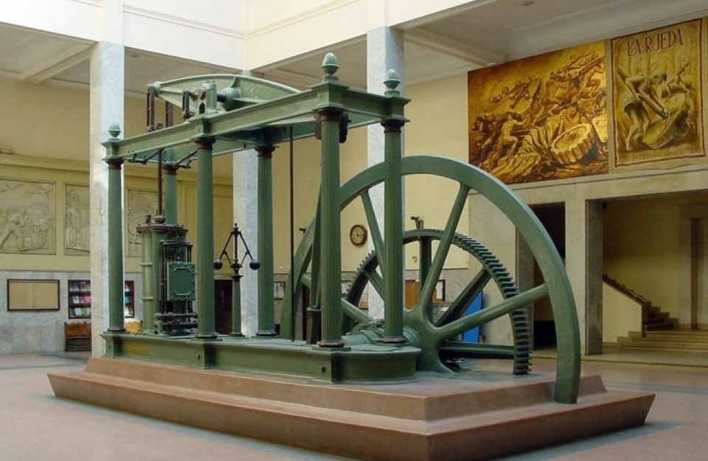
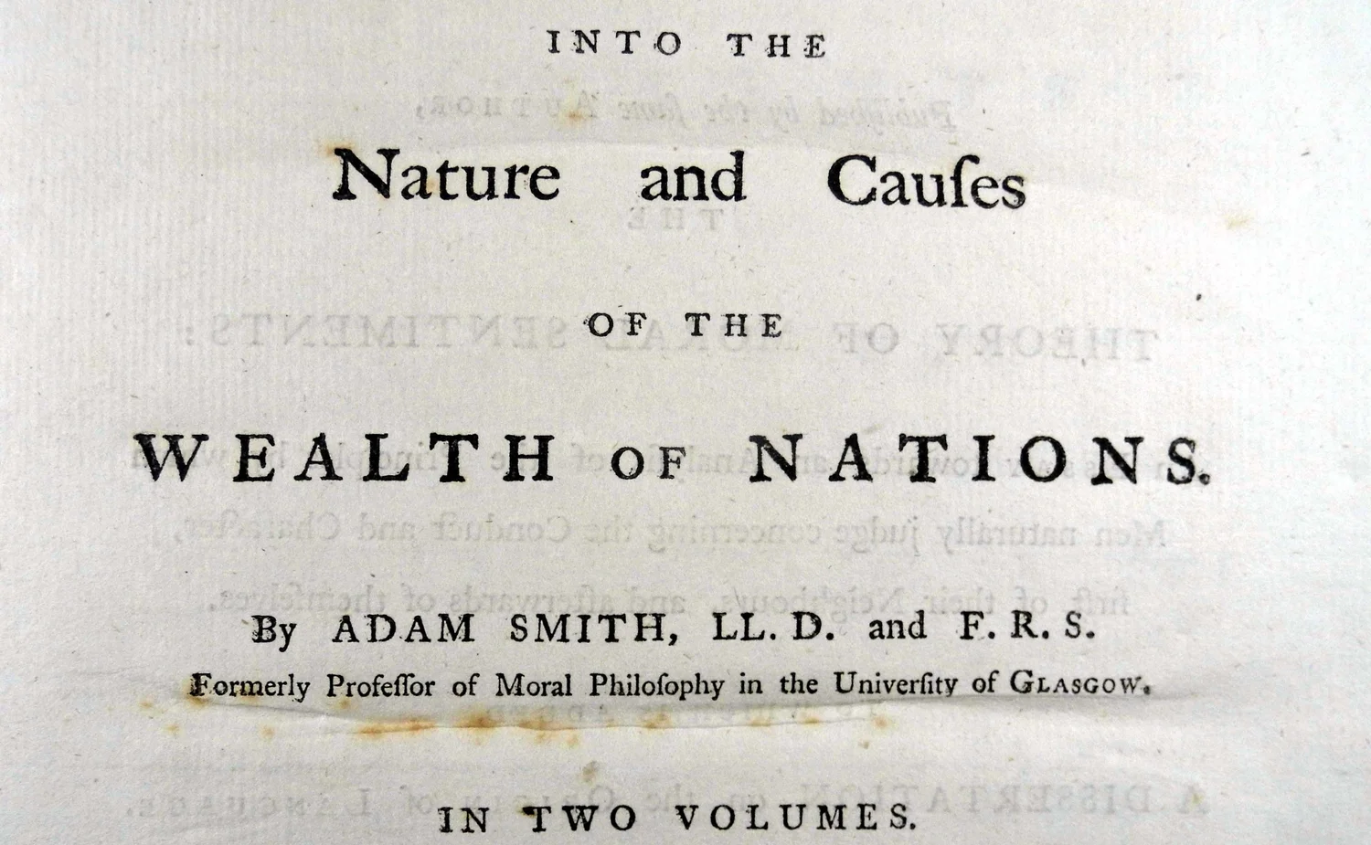
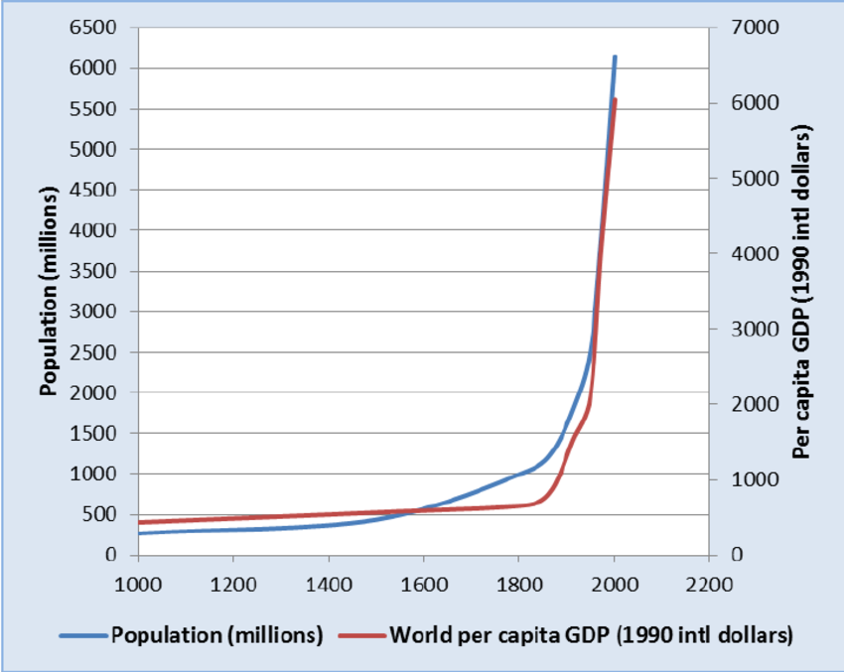
Crescita economioca: un fenomeno recente
It all started in 1776 when the new design of the James Watt steam engine was first introduced …
… and Adam Smith published is seminal contribution “Into the nature and causes of the Wealth of nations”

Slide 3
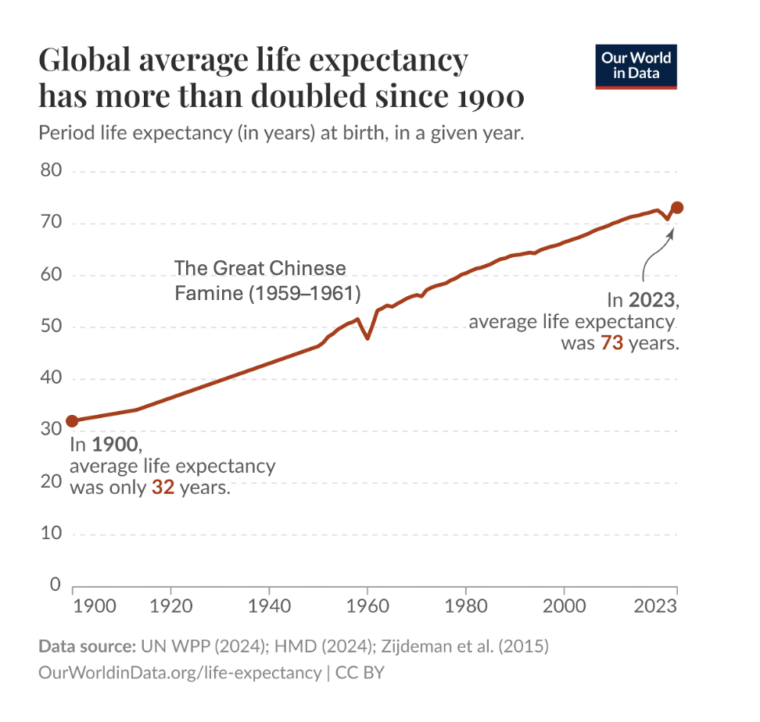
… che ha portato tanti benefici …

Slide 4
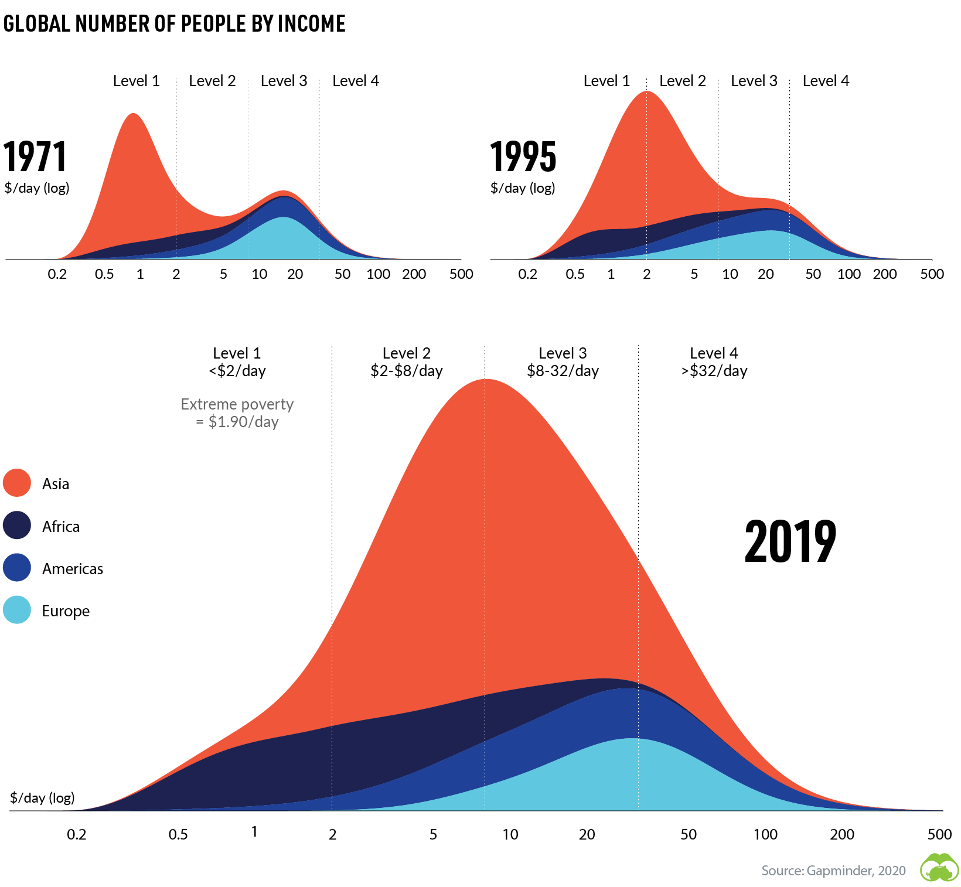
… e convergenza …

Slide 5
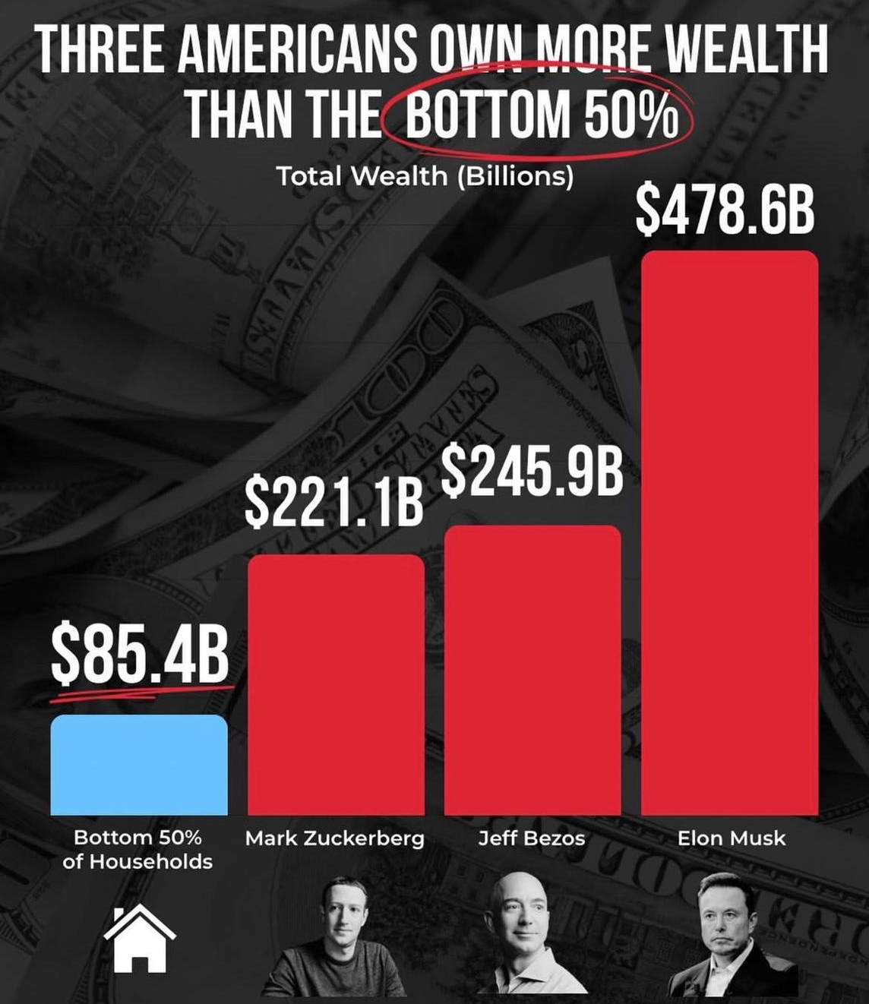
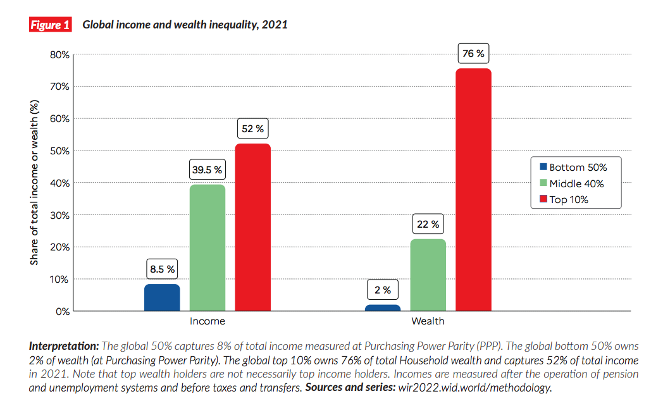
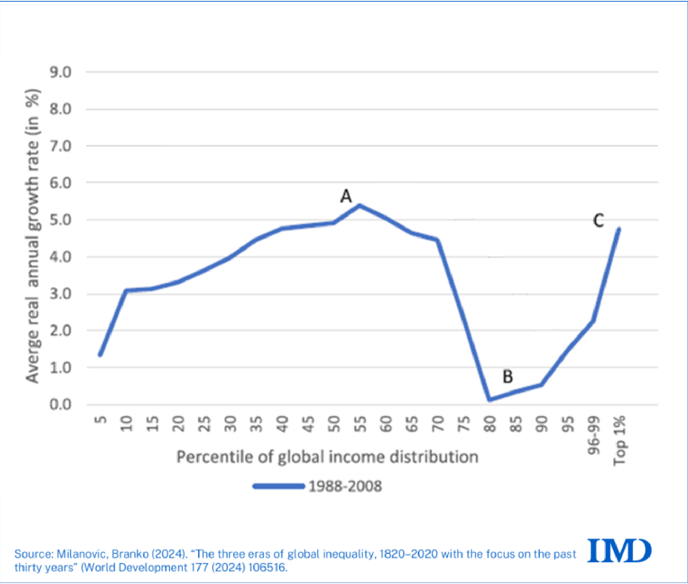
… ma anche squilibri sociali …

Slide 6
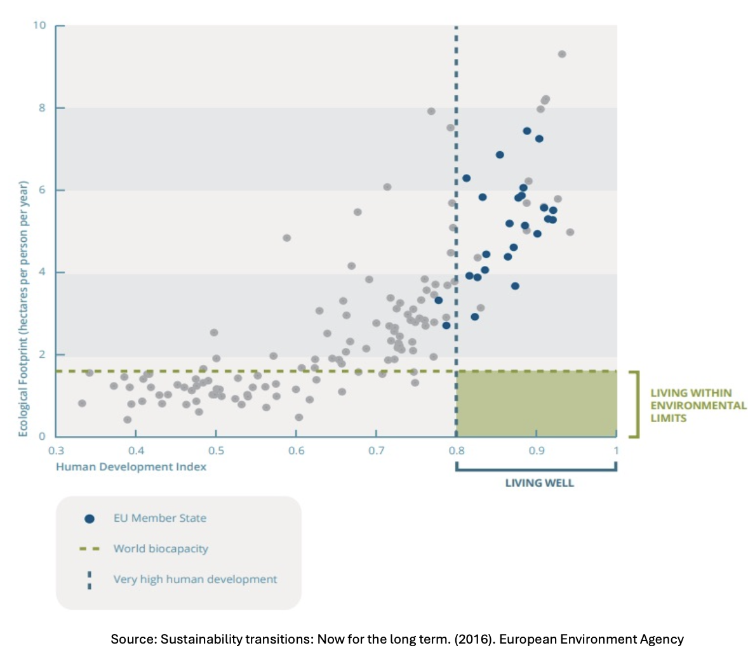
… e criticità ambientali

Slide 7
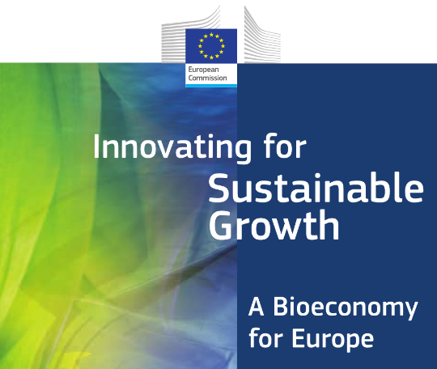
È possibile riconciliare la crescita economica con la sostenibilità sociale ed ambientale?
The transition towards a circular and sustainable bioeconomy New production and consumption models
Just transition – Leaving No One Behind

Slide 8
The EU Bioeconomy Strategy
Obiettivi e visione
Posizionare la bioeconomia come un pilastro della crescita verde, della competitività industrial e della resilienza
Accelerare la decarbonizzazione e ridurre la dipendenza dalle esportazioni impiegando in maniera efficiente e pulitale risorse naturali
Sfruttare il potenziale di crescita della bioeconomia per creare green jobs, promuovere lo sviluppo delle aree rurali e costiere e favorire lo sviluppo sostenibile in Europa

Slide 9

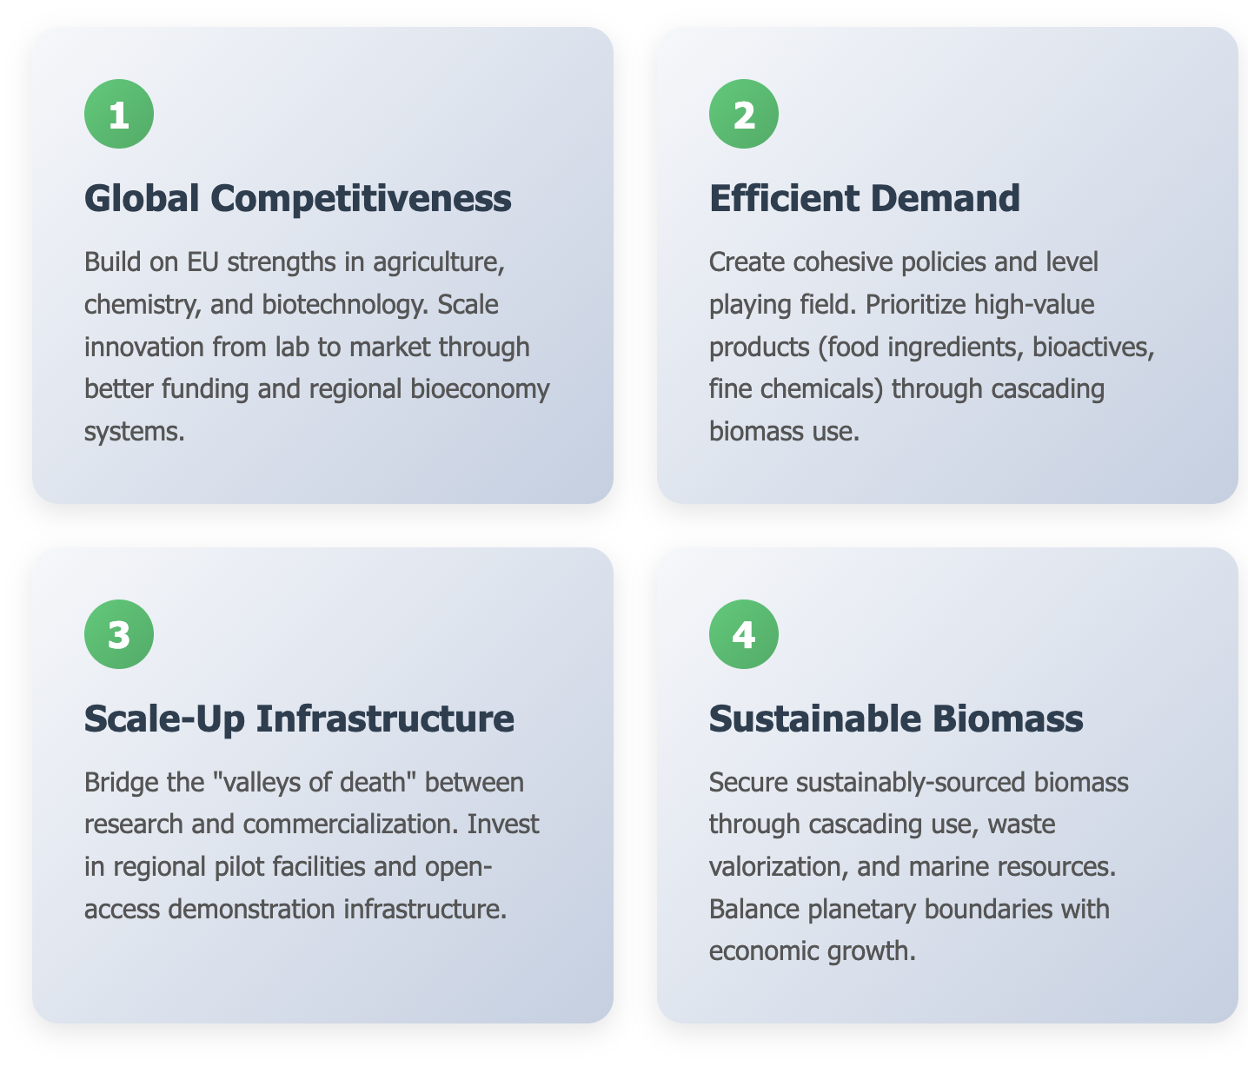
Quattro azioni strategiche per raggiungere questi obiettivi

Slide 10
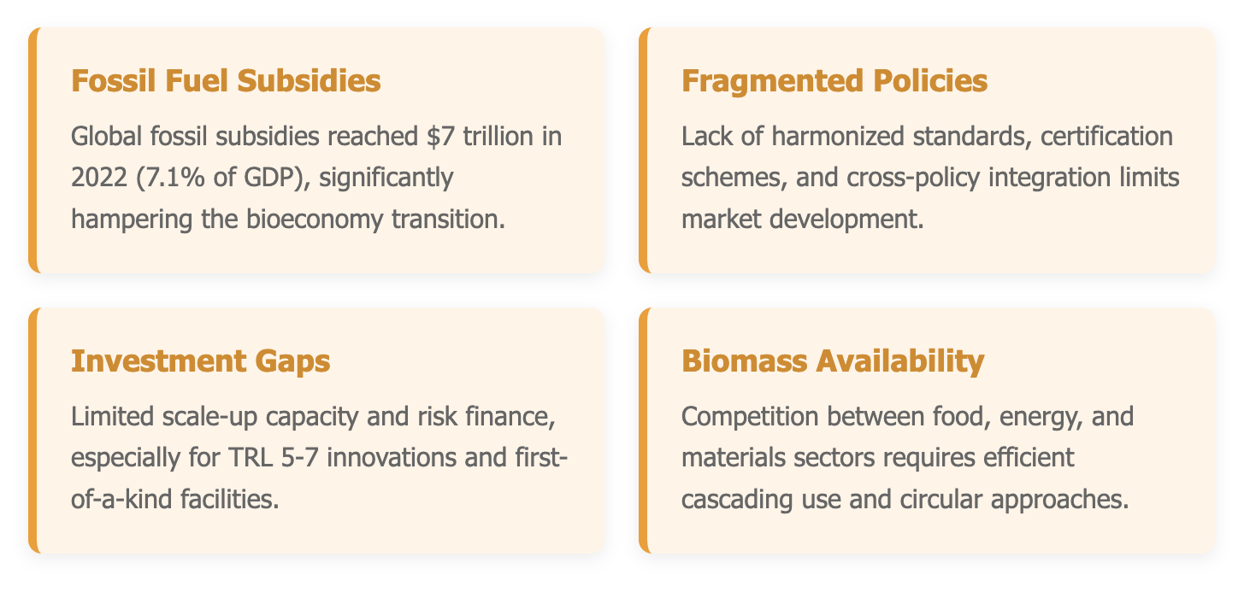
Key Challenges
Notes:
In this project, our team leads Work Package 6, which is focused on Sustainability Assessment.
The aim is to integrate four complementary methodologies: Techno-Economic Analysis (TEA), Life Cycle Assessment (LCA), Biodiversity Impact Assessment (BIA), and Social Life Cycle Assessment (S-LCA). The aim is to capture the full picture of sustainability (economic, environmental, social, and ecological) and ensure that improvements in one area do not create trade-offs in another.
In WP6, our main responsibility is conducting the S-LCA, which evaluates the social impacts and community benefits generated by the project’s model. The aim is to assess how these new biorefinery systems can enhance social well-being, promote equity, and create opportunities for rural stakeholders, including farmers and local communities.
We also contribute to Work Package 7, which focuses on Social Acceptance and Policy. In this area, our team works to integrate sustainability assessment results with behavioural and societal aspects. This approach helps us identify the conditions that can foster broader acceptance and the adoption of small-scale green biorefineries.
Additionally, our contributions inform policy recommendations designed to facilitate the replication of the rural bioeconomy in Europe.

Slide 11
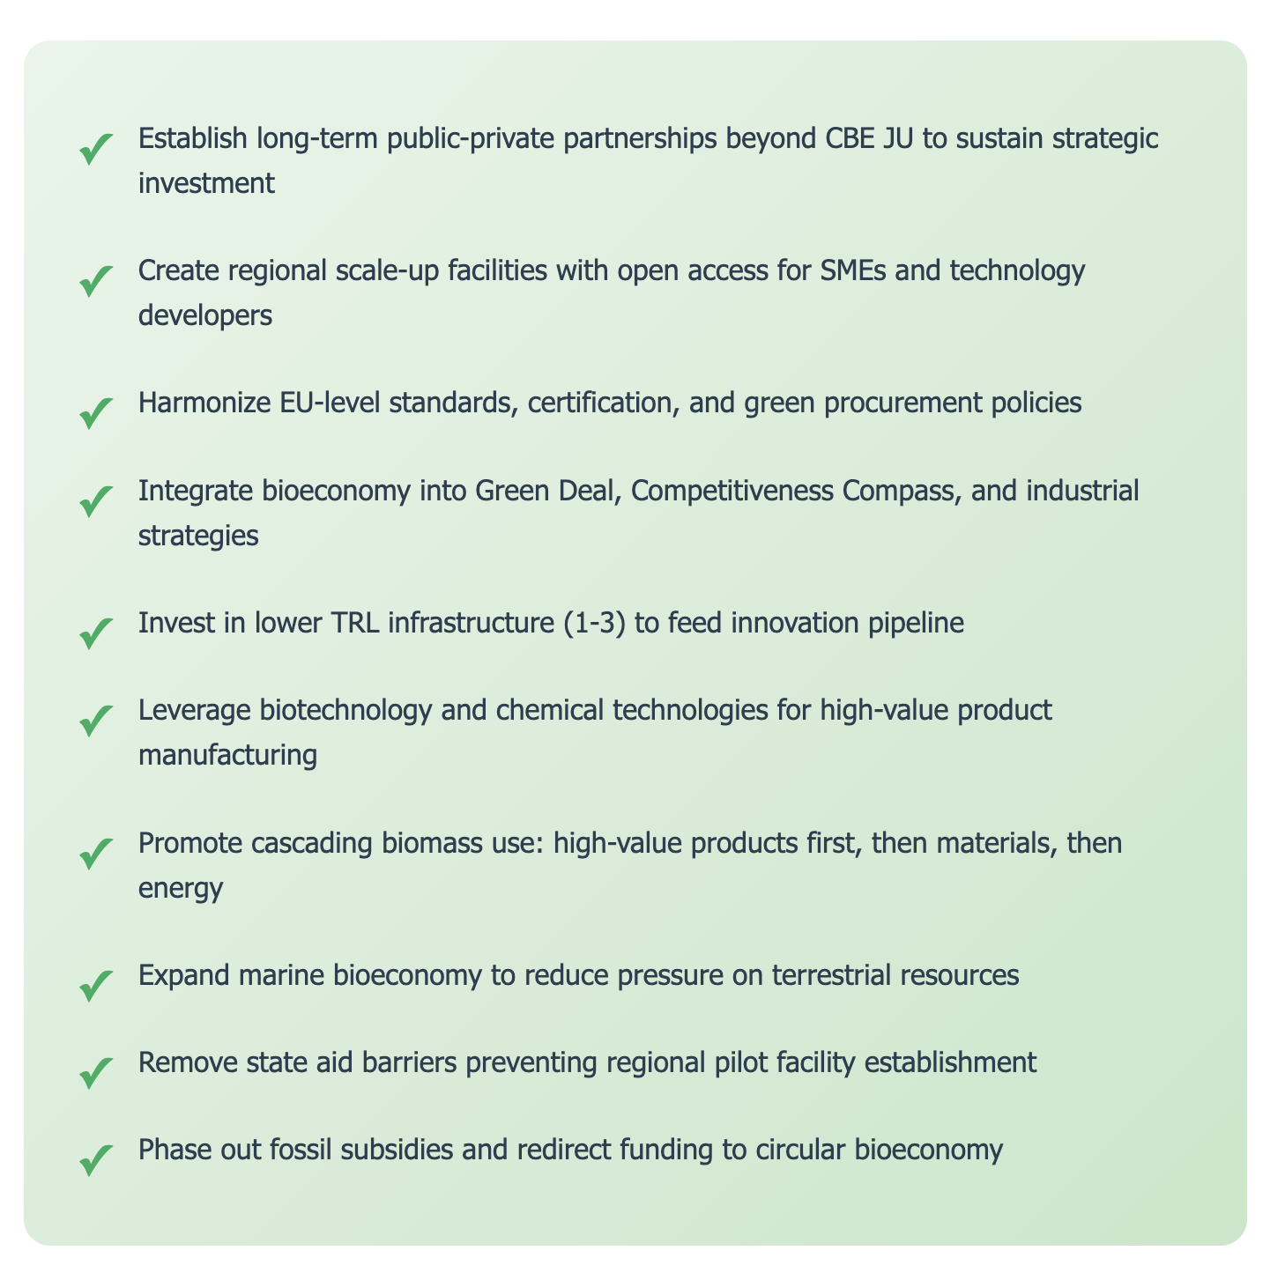
Dalla Strategia al Action Plan
Notes:
In this project, our team leads Work Package 6, which is focused on Sustainability Assessment.
The aim is to integrate four complementary methodologies: Techno-Economic Analysis (TEA), Life Cycle Assessment (LCA), Biodiversity Impact Assessment (BIA), and Social Life Cycle Assessment (S-LCA). The aim is to capture the full picture of sustainability (economic, environmental, social, and ecological) and ensure that improvements in one area do not create trade-offs in another.
In WP6, our main responsibility is conducting the S-LCA, which evaluates the social impacts and community benefits generated by the project’s model. The aim is to assess how these new biorefinery systems can enhance social well-being, promote equity, and create opportunities for rural stakeholders, including farmers and local communities.
We also contribute to Work Package 7, which focuses on Social Acceptance and Policy. In this area, our team works to integrate sustainability assessment results with behavioural and societal aspects. This approach helps us identify the conditions that can foster broader acceptance and the adoption of small-scale green biorefineries.
Additionally, our contributions inform policy recommendations designed to facilitate the replication of the rural bioeconomy in Europe.

Slide 12
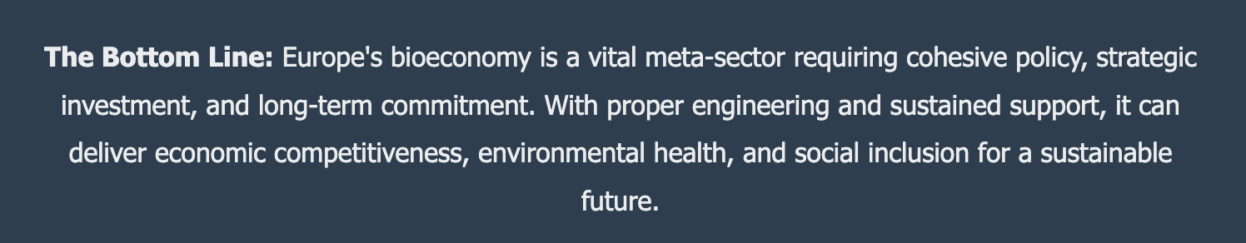
Notes:
In this project, our team leads Work Package 6, which is focused on Sustainability Assessment.
The aim is to integrate four complementary methodologies: Techno-Economic Analysis (TEA), Life Cycle Assessment (LCA), Biodiversity Impact Assessment (BIA), and Social Life Cycle Assessment (S-LCA). The aim is to capture the full picture of sustainability (economic, environmental, social, and ecological) and ensure that improvements in one area do not create trade-offs in another.
In WP6, our main responsibility is conducting the S-LCA, which evaluates the social impacts and community benefits generated by the project’s model. The aim is to assess how these new biorefinery systems can enhance social well-being, promote equity, and create opportunities for rural stakeholders, including farmers and local communities.
We also contribute to Work Package 7, which focuses on Social Acceptance and Policy. In this area, our team works to integrate sustainability assessment results with behavioural and societal aspects. This approach helps us identify the conditions that can foster broader acceptance and the adoption of small-scale green biorefineries.
Additionally, our contributions inform policy recommendations designed to facilitate the replication of the rural bioeconomy in Europe.

Slide 13
Questions & Answers
Contact Details
Piergiuseppe Morone
piergiuseppe.morone@unitelmasapienza.it

